Slide 1
SMART INSOLE
Embedded Systems Group Project

Slide 2
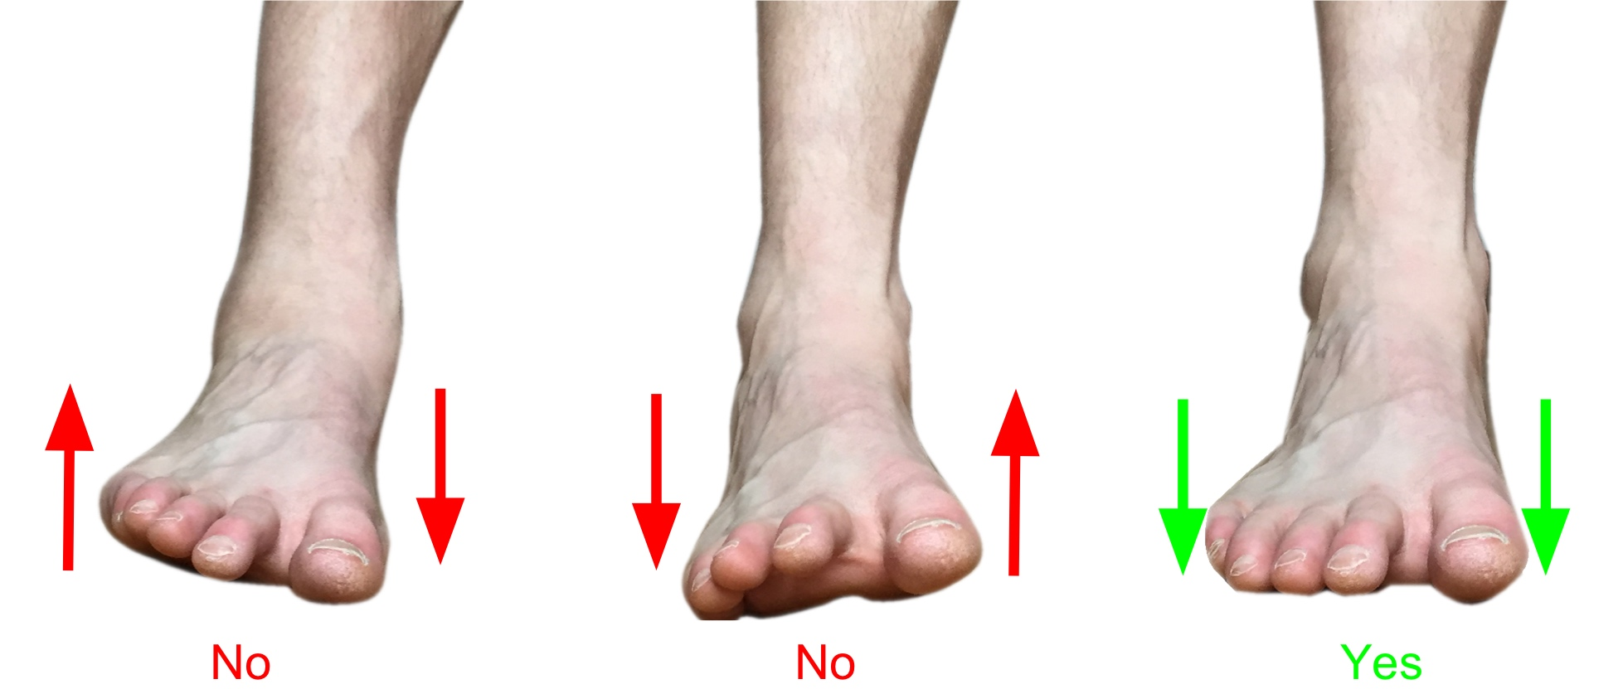
Problem?
Unable to detect symptoms of diseases early( detect neuropathy)
Busy lifestyle ->> cannot go to checkups daily
Unable to identify foot disorders
Unable to identify wrong walking patterns and postures

Slide 3
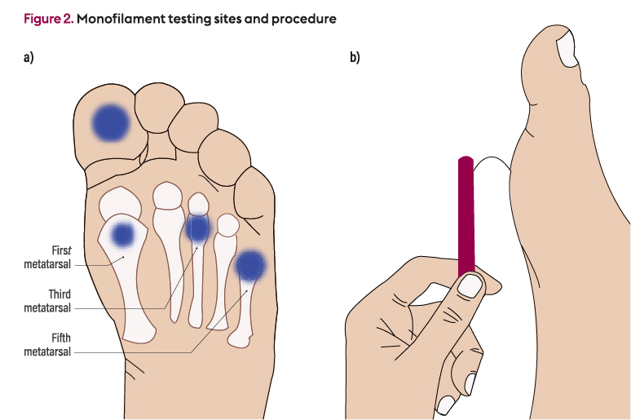
What is this Diabetic Neuropathy?
Lose sensation
development of high pressure areas in feet
ulceration
How to prevent from it ??
Identify abnormal pressure patterns under the foot

Slide 4
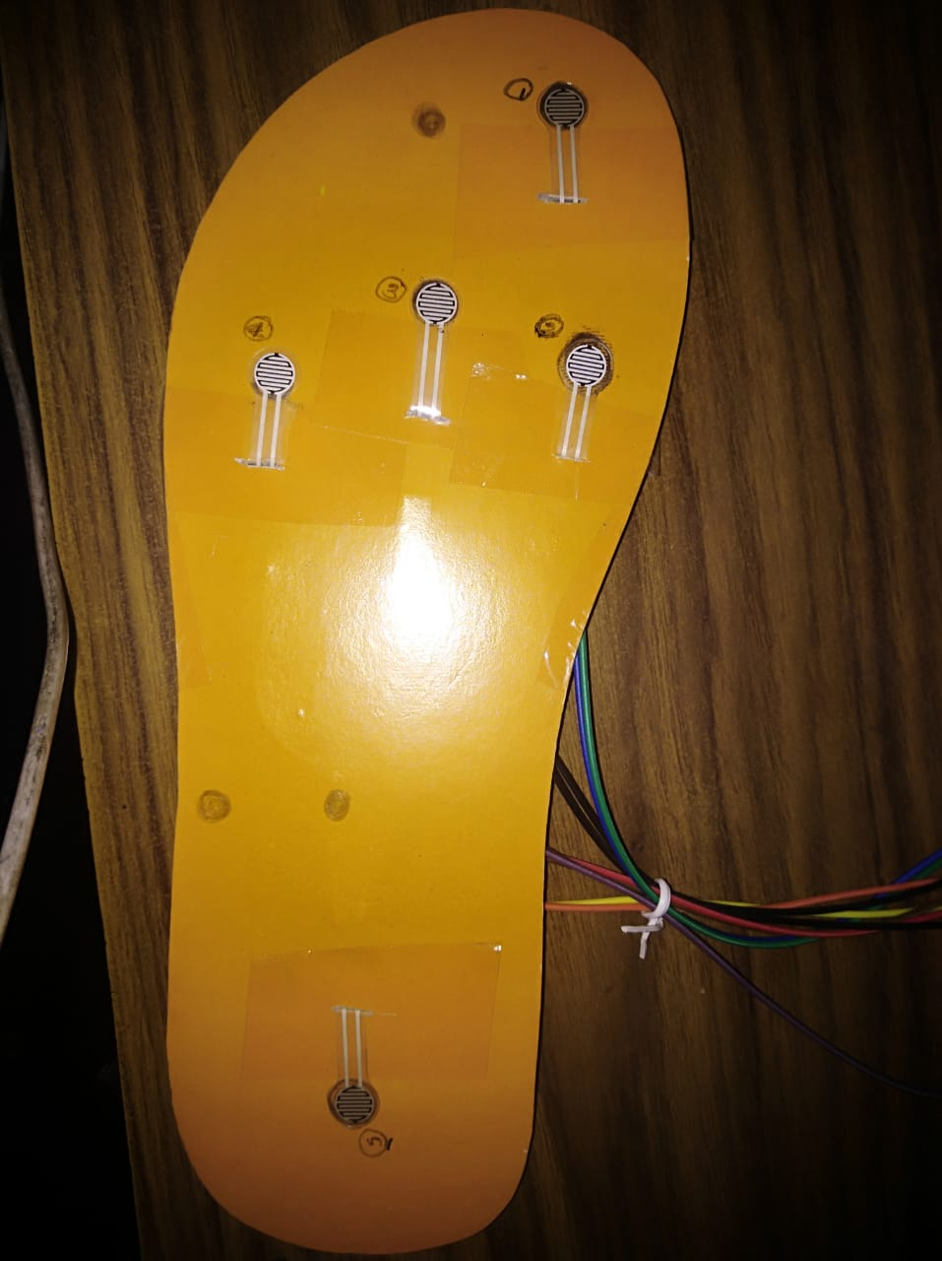
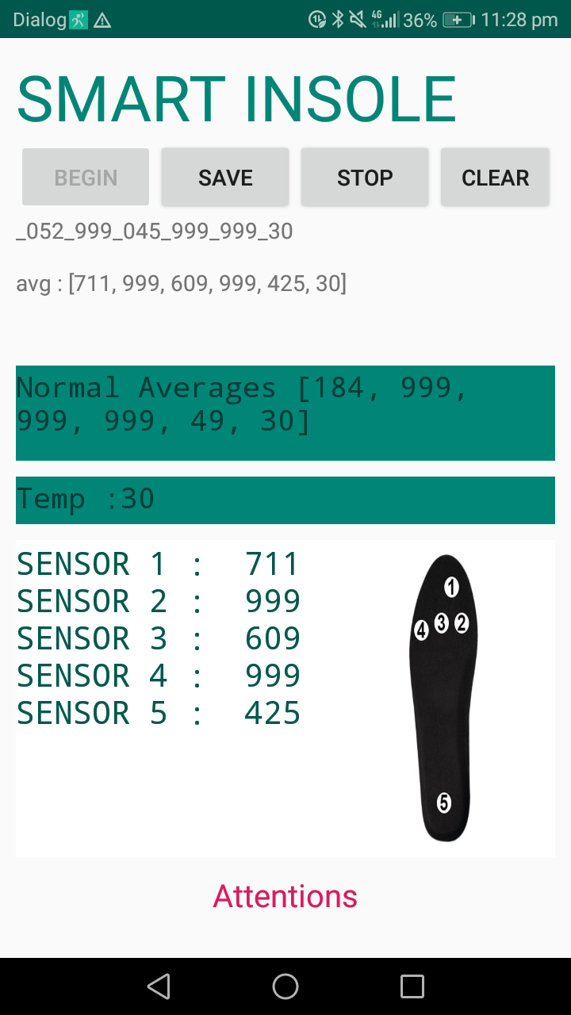
Solution Smart Insole
An Insole to monitor the pressure distribution patterns of foot.
Measure the temperature inside the patient’s shoe(high foot temperature has a correlation with neuropathy )
Send that data to a mobile application.
Predict the results

Slide 5

28
Goal Achieving Milestones…

Slide 6

1st Milestone Identify the Idea
Find information from research papers
Identified technologies
Why we are using Bluetooth?
Short distance, low power
Learned the theories of planter pressure distribution on foot
Identified Technologies
Microcontroller-Arduino Uno
Flexi Force Sensors
Temperature Sensor
Bluetooth

Slide 7
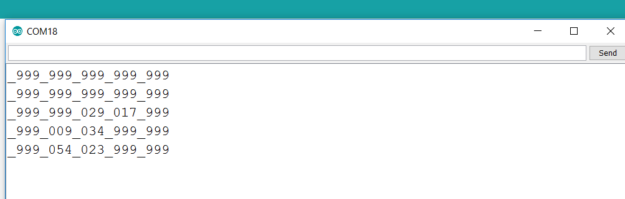
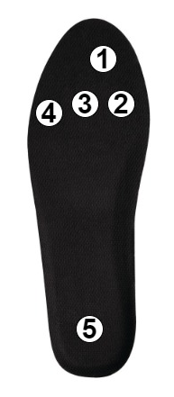
2nd Milestone Measuring pressure distribution on foot
Identify high risk points
High risky points are 1,2,3,and 4
Position sensors on relevant points
Measure resistance variations of sensors with Arduino Uno

Slide 8
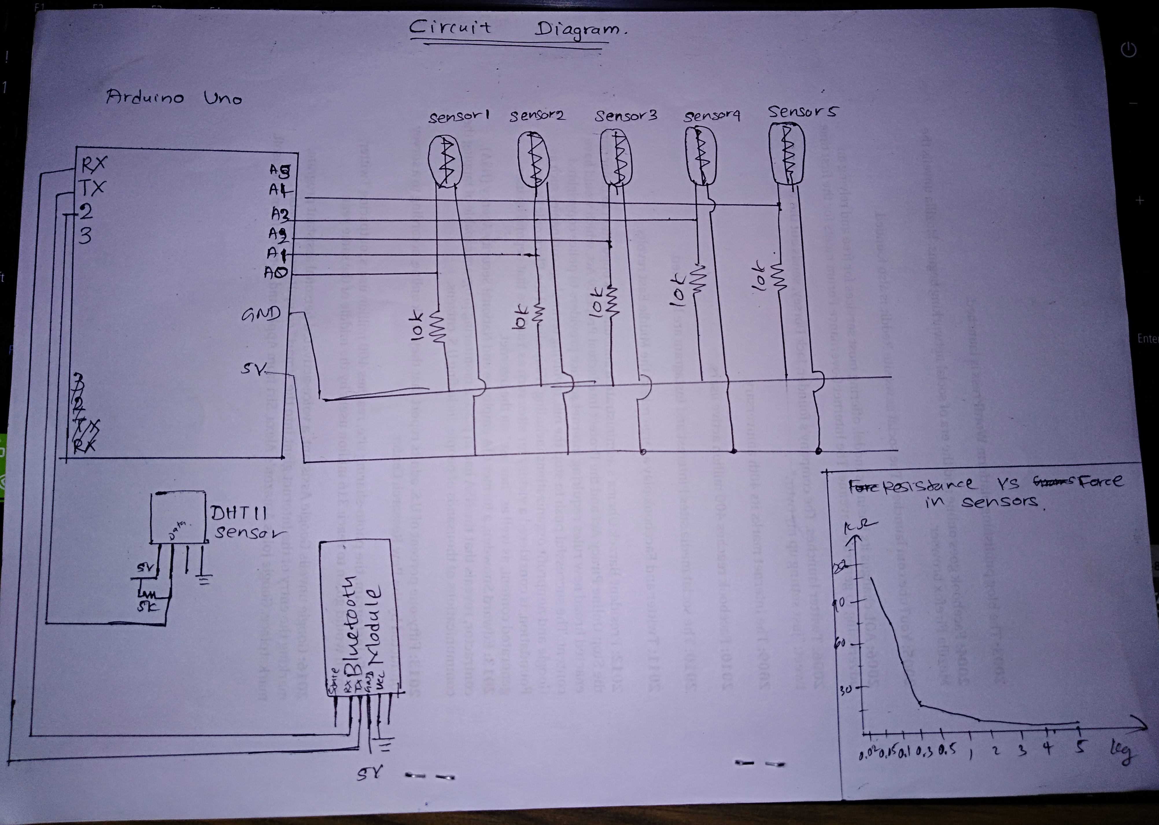
Circuit Diagram Sketches

Slide 9
3rd Milestone Communicate data to mobile app
Get Averages of pressure values
Compare with the normal pressure values
Predict the healthy level

Slide 10


Future Goals
Human Body Weight Prediction
Identify walking patterns(walking , Running)
Develop the data set analysis process with machine learning

Slide 11



Challenges…
Need to do some practical trainings of the device with diabetic patients
Need more Analysis of data
Face to challenges
Need of good medical knowledge
Time Management

Slide 12
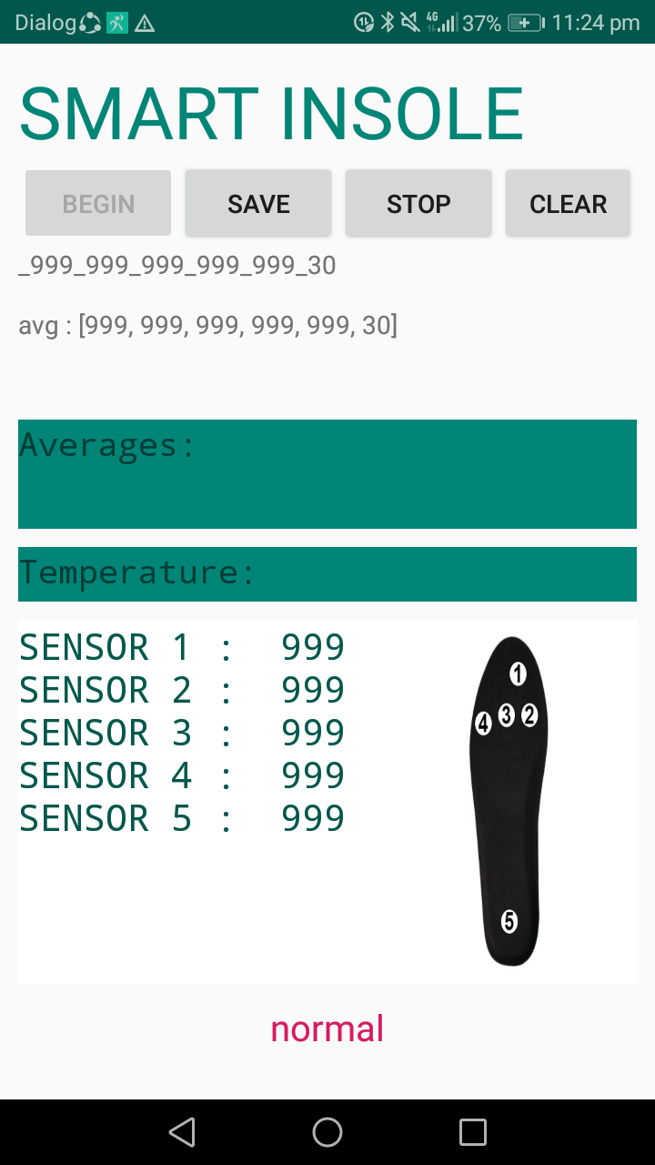
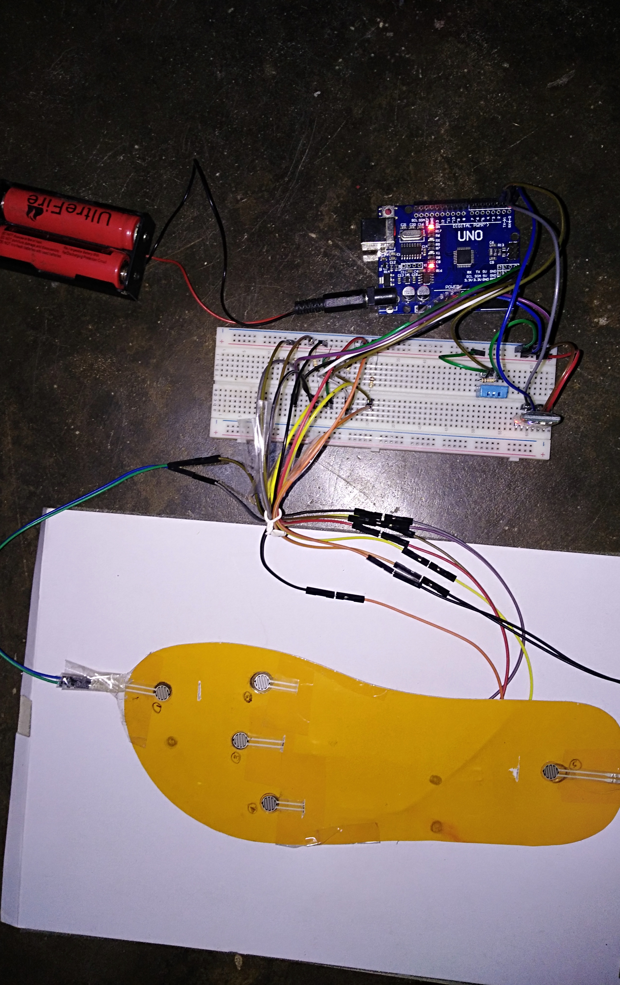

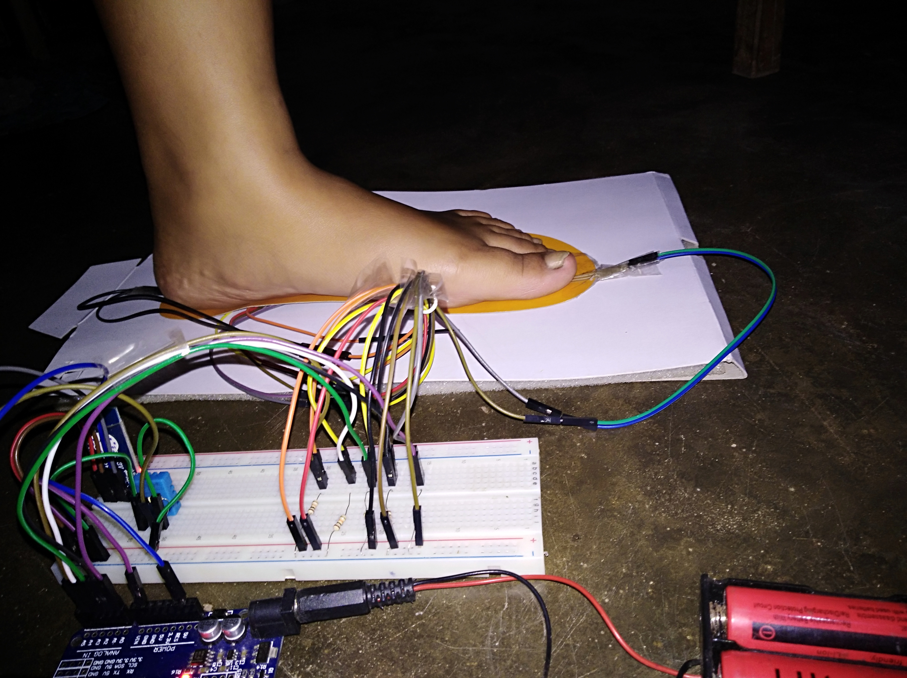
Photo Collage

Slide 13
Thank You!

